Slide 1


Victorien Goudeau
23/02/2024

Slide 2

Outline
Executive Summary
Introduction
Methodology
Results
Conclusion
Appendix

Slide 3
Executive Summary
Summary of methodologies :
Gathered information from the public SpaceX API and the SpaceX section on Wikipedia. Developed a 'class' label for the dataset to denote the outcome of landings. Analyzed the dataset using SQL queries, graphical data representations, folium-based geographic mapping, and interactive dashboards. Selected pertinent data columns to serve as input features for model training. Converted all non-numeric categories into binary form through one-hot encoding techniques. Normalized the dataset and employed GridSearchCV for the optimization of hyperparameters in various machine learning algorithms. Created visual representations to compare the accuracy of the predictive models.
Summary of all results :
Utilized a quartet of machine learning strategies — Logistic Regression, Support Vector Machine, Decision Tree Classifier, and K Nearest Neighbors — to analyze the dataset. These methods demonstrated a uniform level of predictive proficiency, converging on an accuracy rate in the vicinity of 83.33%. A notable bias was observed across all models, indicating a propensity to forecast successful landings with greater frequency than is empirically observed. This suggests a need for a more robust dataset to refine the accuracy of the models and ensure a more balanced prediction outcome.

Slide 4
Introduction
Project background and context :
The advent of the Commercial Space Age has arrived, with Space X leading the charge by offering competitive pricing at $62 million, in contrast to the $165 million USD market average. This price advantage is attributed largely to their innovative capability to recover the first stage of their rockets. In response to this, Space Y is aiming to become a contender in this new space race.
Problems you want to find answers :
Space Y has assigned us the objective to develop and train a machine learning model that can accurately predict the likelihood of a successful recovery of the first stage of their rockets. This predictive model is crucial for Space Y to optimize their recovery processes and effectively compete with Space X.

Slide 5

Section 1

Slide 6
Methodology
Executive Summary
Data collection methodology:
Combined data from SpaceX public API and SpaceX Wikipedia page
Perform data wrangling
Classifying true ladings as successful and unsuccessful otherwise
Perform exploratory data analysis (EDA) using visualization and SQL
Perform interactive visual analytics using Folium and Plotly Dash
Perform predictive analysis using classification models
Tuned models using GridSearchCV

Slide 7
Data Collection
The process of acquiring data was a multi-faceted approach that utilized both direct API requests from the publicly available Space X API and the extraction of information through web scraping techniques applied to Space X's Wikipedia page. The subsequent slide is designed to illustrate the methodology of data procurement via the API, while the slide following that will detail the process of data extraction through web scraping.
The data attributes retrieved from the Space X API encompass a range of columns including:
FlightNumber: The specific number assigned to each flight.
Date: The date of the launch.
BoosterVersion: The version of the rocket booster used.
PayloadMass: The mass of the payload carried by the rocket.
Orbit: The intended orbit for the payload.
LaunchSite: The geographical location from which the rocket was launched.
Outcome: The result of the launch, particularly the success or failure of missions.
Flights: The number of flights conducted by the booster.
GridFins: The presence of grid fins on the booster, which aid in its control during descent.
Reused: Whether the booster was previously used in other flights.
Legs: The presence of landing legs on the booster.
LandingPad: The designated location for the booster landing.
Block: The block or generation of the booster.
ReusedCount: The number of times the booster has been reused.
Serial: The serial number of the booster.
Longitude: The longitudinal coordinate of the launch site.
Latitude: The latitudinal coordinate of the launch site.
In parallel, the columns extracted from Wikipedia through web scraping include:
Flight No.: Corresponds to FlightNumber from the API data, indicating the flight sequence.
Launch site: Same as LaunchSite, indicating the departure point of the rocket.
Payload: Refers to the cargo carried by the mission.
PayloadMass: Mirroring the PayloadMass from the API, denoting the mass of the cargo.
Orbit: Identical to Orbit from the API, describing the intended trajectory.
Customer: The entity for which the launch is conducted.
Launch outcome: Equivalent to Outcome, detailing the result of the launch.
Version Booster: Similar to BoosterVersion, detailing the booster's version.
Booster landing: The status of the booster's landing attempt.
Date: The date of the launch event.
Time: The specific time at which the launch took place.

Slide 8
Data Collection – SpaceX API
Request
.JSON Configuration and Arrays of Key Data (Launch Sites, Booster Versions, Payload Details)
Normalize to Dataframe from Json
Github url : applied-capstone-project/week 1/jupyter-labs-spacex-data-collection-api.ipynb
Catalog of pertinent information
Cast dictionary to a dataframe
Only take the Falcon 9 launches
Replace missing values with mean

Slide 9
Data Collection - Scraping
Request Wikipedia html
Parser data with BeautifulSoup
Find Launch info html table
Github url : applied-capstone-project/week 1/jupyter-labs-webscraping.ipynb at main · Victorien-Goudeau/applied-capstone-project (github.com)
Create dictionary
Iterate through table cells to extract data
Cast dictionary to a dataframe

Slide 10
Data Wrangling
Develop a 'class' training label to categorize landing outcomes into successes and failures, assigning the numerical value of 1 to represent success and 0 to denote failure. This categorization relies on evaluating two aspects within the 'Outcome' column: the 'Mission Outcome' and the 'Landing Location'. The criterion for a successful landing, and thus a 'class' value of 1, is met exclusively when the 'Mission Outcome' is confirmed as True, independent of the 'Landing Location'. This encompasses scenarios tagged as True ASDS (Autonomous Spaceport Drone Ship), True RTLS (Return to Launch Site), and True Ocean. In contrast, configurations identified as None None, False ASDS, None ASDS, False Ocean, and False RTLS, which indicate either a lack of attempt or a failed landing, are systematically assigned a 'class' value of 0, highlighting their unsuccessful outcomes.Add the GitHub URL of your completed data wrangling related notebooks, as an external reference and peer-review purpose
applied-capstone-project/week 1/labs-jupyter-spacex-Data wrangling.ipynb at main · Victorien-Goudeau/applied-capstone-project (github.com)

Slide 11
EDA with Data Visualization
An Exploratory Data Analysis (EDA) was conducted focusing on the variables Flight Number, Payload Mass, Launch Site, Orbit, Class, and Year to uncover patterns, relationships, and trends within the dataset. This analysis utilized a combination of scatter plots, line charts, and bar plots to visually compare and contrast the interactions between these variables, providing insights into their potential influence on space launch outcomes.
The plots created and their purposes were as follows:
Flight Number vs. Payload Mass: A scatter plot to observe if there's a correlation between the flight number (indicating the chronological order of launches) and the payload mass, potentially revealing trends in payload capacity over time.
Flight Number vs. Launch Site: A scatter or bar plot to examine whether certain launch sites are favored as the flight number increases, indicating a possible preference or specialization in launch sites over time.
Payload Mass vs. Launch Site: A scatter or bar plot to determine if specific launch sites are associated with particular payload mass ranges, suggesting site capabilities or mission profiles.
Orbit vs. Success Rate: A bar plot to analyze the success rate by orbit type, identifying which orbits have higher success rates and could be considered more reliable or less risky.
Flight Number vs. Orbit: A scatter or line plot to see if there's a pattern in the types of orbits chosen for missions over time, indicating shifts in mission objectives or technology.
Payload vs. Orbit: A scatter plot to explore the relationship between payload mass and orbit destination, hypothesizing that certain orbits require or can accommodate different payload masses.
Success Yearly Trend: A line chart to track the success rate of launches over the years, identifying any trends in performance improvement or decline.
These visualizations are crucial for identifying relationships and trends that can inform the training of a machine learning model. By understanding how different variables interact and affect launch outcomes, one can select the most relevant features for predicting future launch success, enhancing the model's accuracy and reliability.
applied-capstone-project/week 2/jupyter-labs-eda-dataviz.ipynb at main · Victorien-Goudeau/applied-capstone-project (github.com)

Slide 12
EDA with SQL
The dataset was imported into an IBM DB2 Database, facilitating the use of SQL within a Python integration to deeply explore the data. Through SQL queries, comprehensive insights were gleaned regarding various aspects of the dataset, specifically:
Launch Site Names: Queries identified the different launch sites involved in the dataset, enabling an understanding of the geographic distribution and frequency of launches from these sites.
Mission Outcomes: The data was examined to categorize and count the different outcomes of missions, providing a clear view of success rates and potential areas for improvement.
Payload Sizes of Customers: By querying the dataset, information was obtained on the payload sizes associated with different customers, offering a perspective on the range and average payload masses that customers are sending to space.
Booster Versions: The analysis included identifying the various booster versions used across missions, which could indicate technological advancements and preferences in booster usage over time.
Landing Outcomes: Detailed information was extracted about the outcomes of landings, whether successful or failed, to assess the effectiveness of different landing technologies and approaches.
This structured approach to querying the dataset not only allowed for a detailed exploration of specific facets of the space missions but also enabled the identification of trends, preferences, and performance metrics critical for future missions and technology development.
applied-capstone-project/week 2/jupyter-labs-eda-sql-coursera_sqllite.ipynb at main · Victorien-Goudeau/applied-capstone-project (github.com)

Slide 13
Build an Interactive Map with Folium
Folium maps are utilized to pinpoint Launch Sites, delineate both successful and unsuccessful landings, and illustrate proximity to essential landmarks such as Railways, Highways, Coasts, and Cities. This visualization aids in comprehending the rationale behind the geographical placement of launch sites, as well as in observing how the success of landings correlates with their locations.
applied-capstone-project/week 3/lab_jupyter_launch_site_location.ipynb at main · Victorien-Goudeau/applied-capstone-project (github.com)

Slide 14
Build a Dashboard with Plotly Dash
The dashboard features a pie chart and a scatter plot for data visualization. The pie chart is configurable to display either the overall distribution of successful landings at all launch sites or the success rates for each individual launch site. Meanwhile, the scatter plot allows for the selection of data from all sites or a specific site, with the additional option to adjust payload mass via a slider ranging from 0 to 10,000 kg. The pie chart effectively illustrates the success rates associated with different launch sites, while the scatter plot provides insights into the variation of success rates based on launch site selection, payload mass, and the category of booster version used.
applied-capstone-project/week 3/SpaceX dash app.py at main · Victorien-Goudeau/applied-capstone-project (github.com)

Slide 15
Predictive Analysis (Classification)
Split label column class from dataset
Fit and Transform features using standard scaler
Split train & test data
applied-capstone-project/week 4/SpaceX_Machine_Learning_Prediction_Part_5.jupyterlite.ipynb at main · Victorien-Goudeau/applied-capstone-project (github.com)
Confusion matrix for all models
Score models on test set
Using GridSearchCV to optimize the parameters
Table to compare scores of models

Slide 16
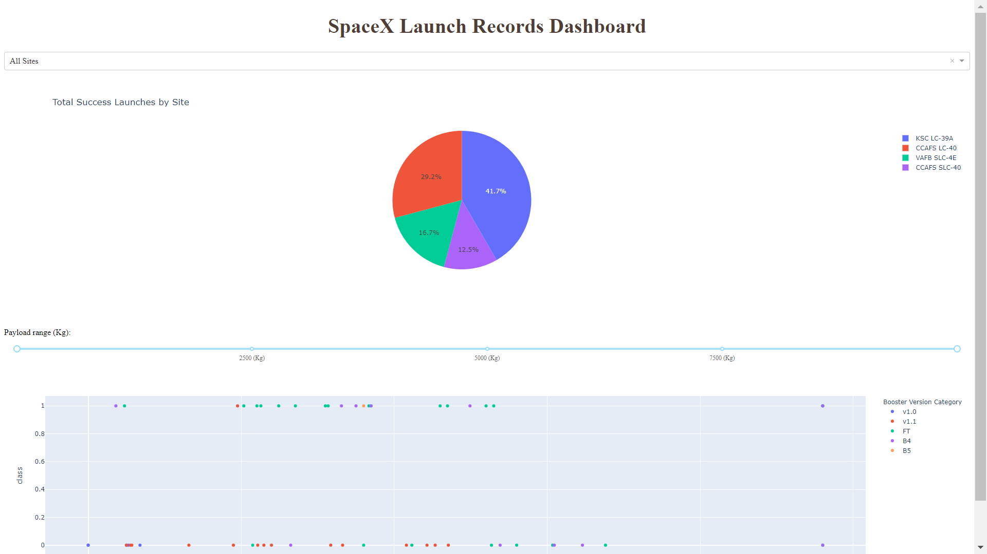
Results
This introduction sets the stage for a comprehensive preview of the Plotly dashboard, designed to showcase the outcomes of an extensive Exploratory Data Analysis (EDA) effort, both through visualization techniques and SQL queries. Following this, an interactive map created with Folium will be presented, offering geographical insights into the data. The culmination of this presentation will focus on the results of our predictive model, which has achieved an accuracy rate of approximately 83%. Each section aims to provide a detailed exploration of the data, from initial analysis to final model performance, offering a holistic view of the project's findings and methodologies.

Slide 17

Section 2

Slide 18
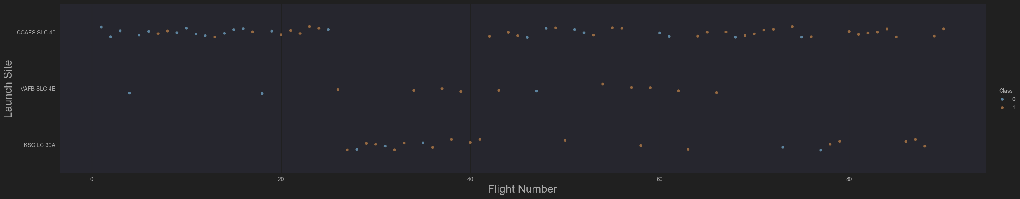
Flight Number vs. Launch Site
The graphical analysis indicates a progressive improvement in the success rate over time, as demonstrated by the data associated with each Flight Number. There appears to be a notable breakthrough around the 20th flight, which markedly enhanced the success rate. Additionally, the Cape Canaveral Air Force Station (CCAFS) emerges as the predominant launch site, evidenced by its higher launch volume compared to other sites. This suggests not only advancements in technology or operational strategies post the 20th flight but also highlights CCAFS's central role in launch operations.

Slide 19
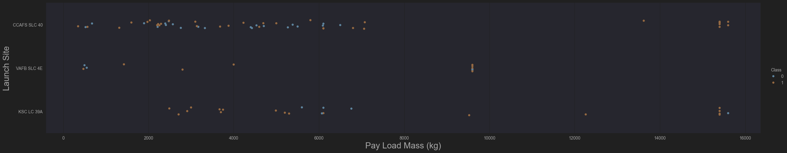
Payload vs. Launch Site
The data analysis reveals that the majority of payload masses range from 0 to 6,000 kg. Furthermore, it's observed that different launch sites tend to handle varying payload masses, suggesting that specific sites may be optimized or preferred for certain types of missions based on their payload requirements. This variation in payload mass across launch sites could reflect the diverse capabilities and specializations of each site.

Slide 20
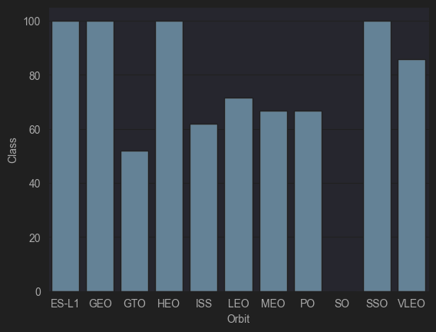
Success Rate vs. Orbit Type
The analysis indicates a shift in orbit preferences over time, as represented by Flight Number, with launch outcomes showing a correlation to these changing preferences. Initially, SpaceX focused on launches to Low Earth Orbit (LEO), where they experienced moderate success. Over time, the company has revisited Very Low Earth Orbit (VLEO) for its more recent missions. The data suggests that SpaceX tends to achieve higher success rates in lower orbits or Sun-synchronous orbits, indicating a potential strategic focus or technological advantage in these specific orbital regimes.

Slide 21
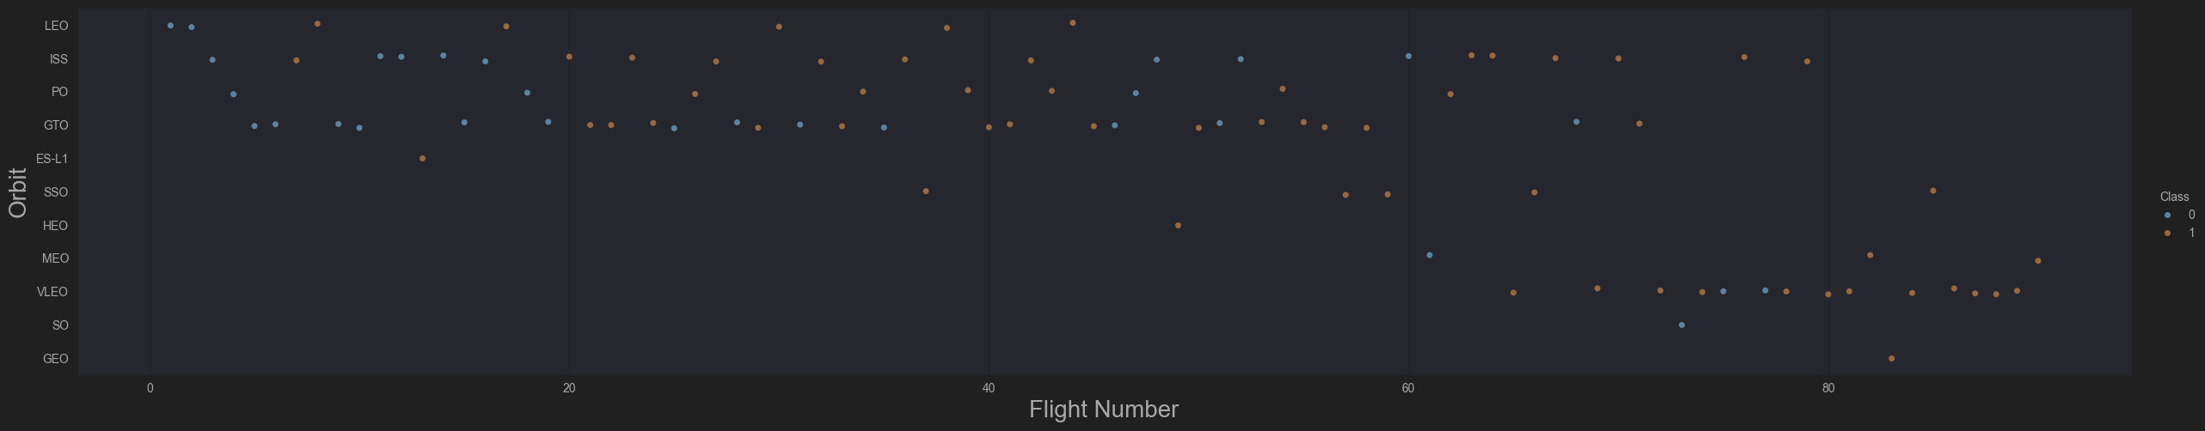
Flight Number vs. Orbit Type
The analysis indicates a shift in orbit preferences over time, as represented by Flight Number, with launch outcomes showing a correlation to these changing preferences. Initially, SpaceX focused on launches to Low Earth Orbit (LEO), where they experienced moderate success. Over time, the company has revisited Very Low Earth Orbit (VLEO) for its more recent missions. The data suggests that SpaceX tends to achieve higher success rates in lower orbits or Sun-synchronous orbits, indicating a potential strategic focus or technological advantage in these specific orbital regimes.

Slide 22
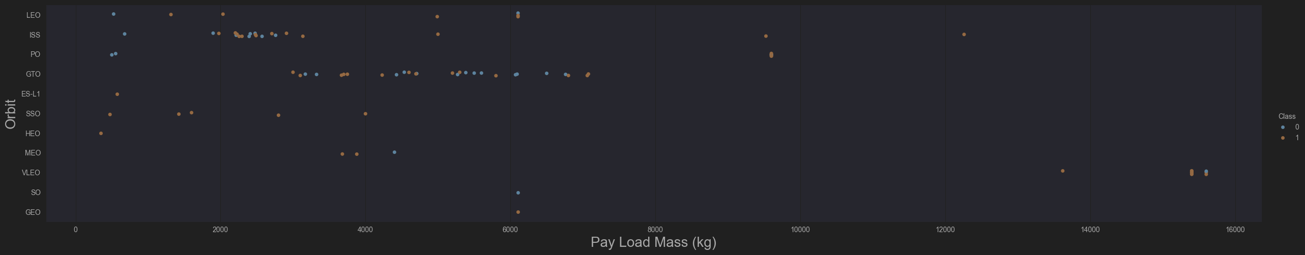
Payload vs. Orbit Type
Payload mass seems to correlate with orbit
LEO and SSO seem to have relatively low payload mass
The other most successful orbit VLEO only has payload mass values in the higher end of the range

Slide 23
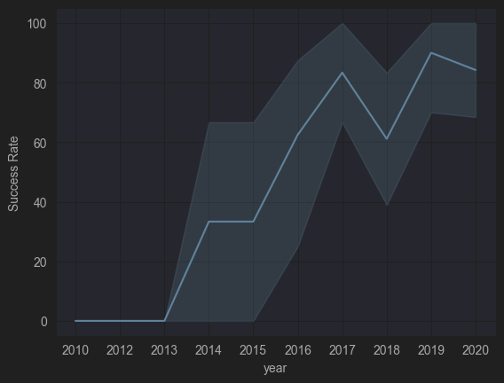
Launch Success Yearly Trend
Success generally increases over time since 2013 with a slight dip in 2018
Success in recent years at around 80%

Slide 24
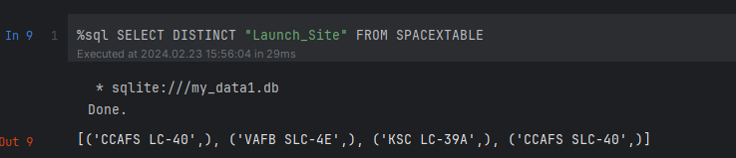
All Launch Site Names
Retrieve distinct launch site names from the database. The names "CCAFS SLC-40" and "CCAFSSLC-40" probably refer to the same site, affected by typographical errors. "CCAFS LC-40" is an outdated designation. It is presumed that there are essentially three unique values for launch sites: "CCAFS SLC-40", "KSC LC-39A", and "VAFB SLC-4E".

Slide 25
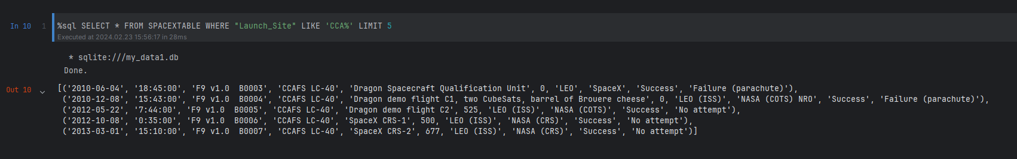
Launch Site Names Begin with 'CCA'
First five entries in database with Launch Site name beginning with CCA.

Slide 26
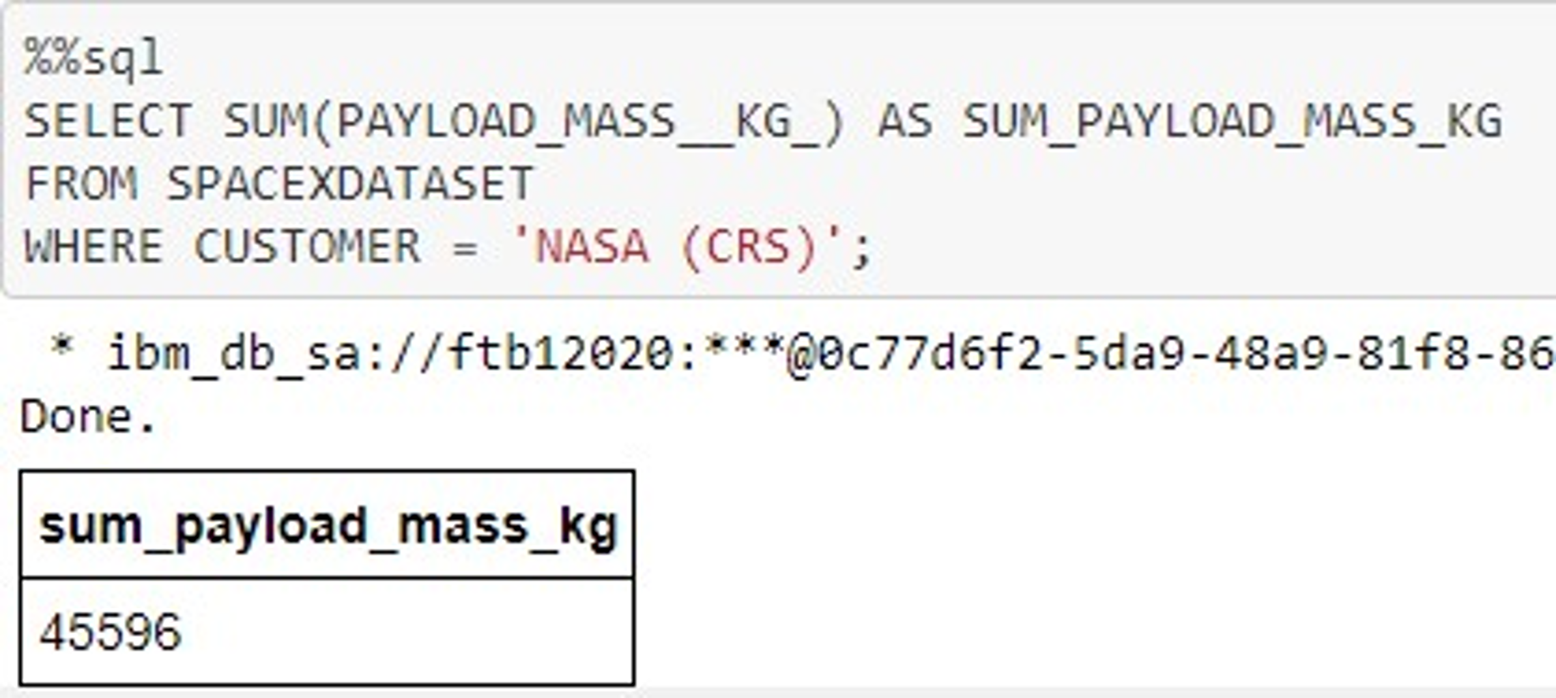
Launch Site Names Begin with 'CCA'
First five entries in database with Launch Site name beginning with CCA.

Slide 27
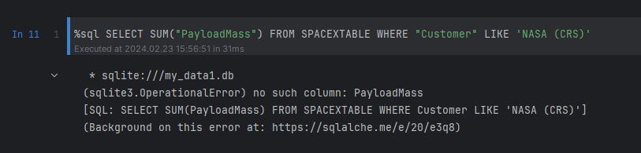
Total Payload Mass
The query calculates the cumulative payload mass in kilograms for missions where NASA served as the customer. "CRS" denotes Commercial Resupply Services, signifying that these payloads were dispatched to the International Space Station (ISS).

Slide 28
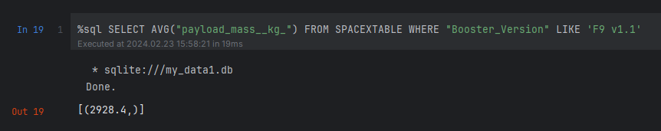
Average Payload Mass by F9 v1.1
The query determines the mean payload mass for launches utilizing the F9 v1.1 booster version. The average payload mass for the F9 v1.1 lies towards the lower spectrum of our payload mass range.

Slide 29
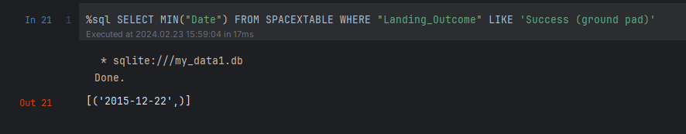
First Successful Ground Landing Date
The query retrieves the date of the first successful ground pad landing. This milestone in ground pad landings was not achieved until the close of 2015. In general, successful landings began to be recorded starting from 2014.

Slide 30
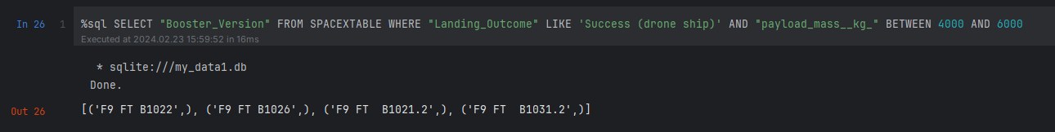
Successful Drone Ship Landing with Payload between 4000 and 6000
The query identifies the four booster versions that achieved successful drone ship landings with a payload mass ranging from 4000 to 6000 kg, excluding the boundaries of this range.

Slide 31
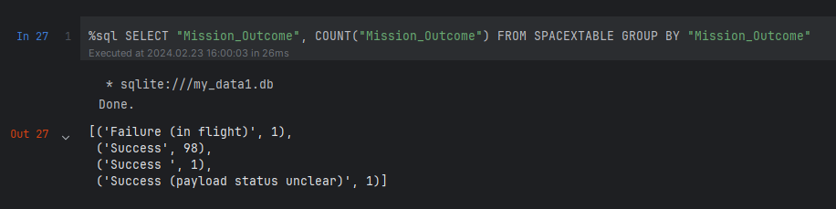
Total Number of Successful and Failure Mission Outcomes
The query calculates the frequency of each mission outcome. It reveals that SpaceX successfully achieves its mission objectives almost 99% of the time, indicating that a majority of landing failures are deliberate or accounted for in the mission planning. Notably, there is one instance where the payload status remains ambiguous, and, regrettably, there has been one in-flight failure.

Slide 32
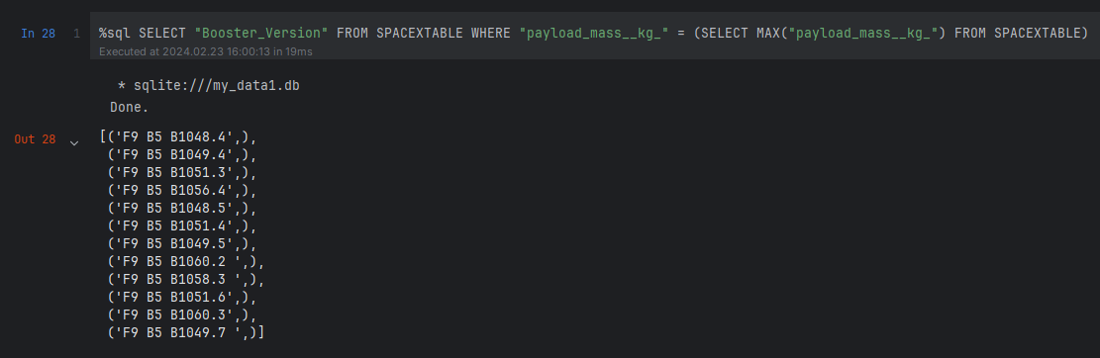
Boosters Carried Maximum Payload
The query identifies the booster versions that have transported the maximum payload mass of 15,600 kg. These booster versions are closely related, all belonging to the F9 B5 B10xx.x series. This similarity suggests a correlation between the payload mass and the specific booster version selected for the mission.

Slide 33
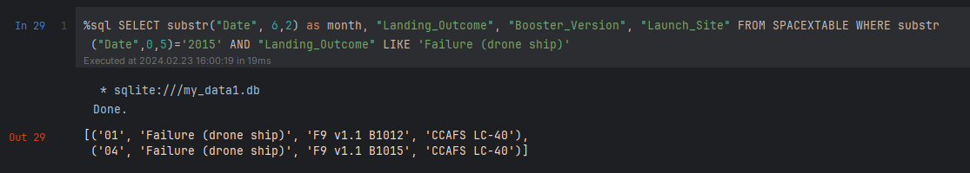
2015 Launch Records
The query fetches the Month, Landing Outcome, Booster Version, Payload Mass (kg), and Launch Site for launches in 2015 where the first stage failed to land on a drone ship. There were two instances of this happening.

Slide 34
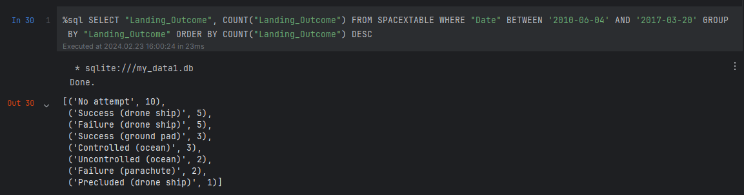
Rank Landing Outcomes Between 2010-06-04 and 2017-03-20
The query generates a list of successful landings occurring between June 4, 2010, and March 20, 2017, inclusive. Successful landings are categorized into two types: those achieved on a drone ship and those on a ground pad. Throughout this specified period, there were a total of 8 successful landings.

Slide 35

Section 3

Slide 36
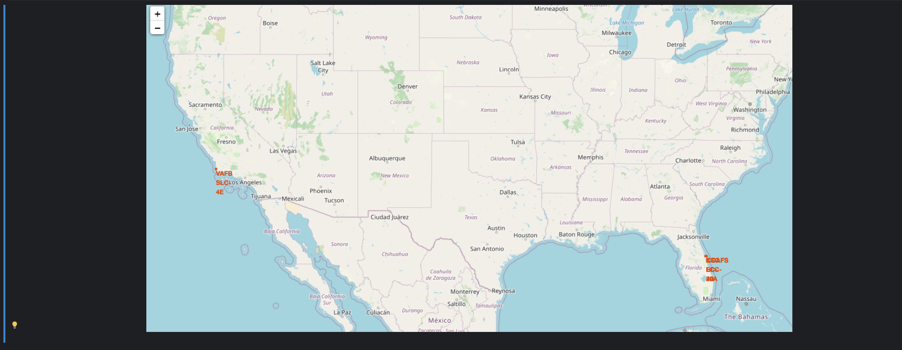
Launch Site Locations
The left map displays all launch sites in relation to the map of the United States, providing a comprehensive view of their geographical distribution. The right map zooms in on the two launch sites located in Florida, highlighting their proximity to one another. Notably, all launch sites are situated near the ocean, reflecting the strategic preference for coastal locations in launch site selection.

Slide 37
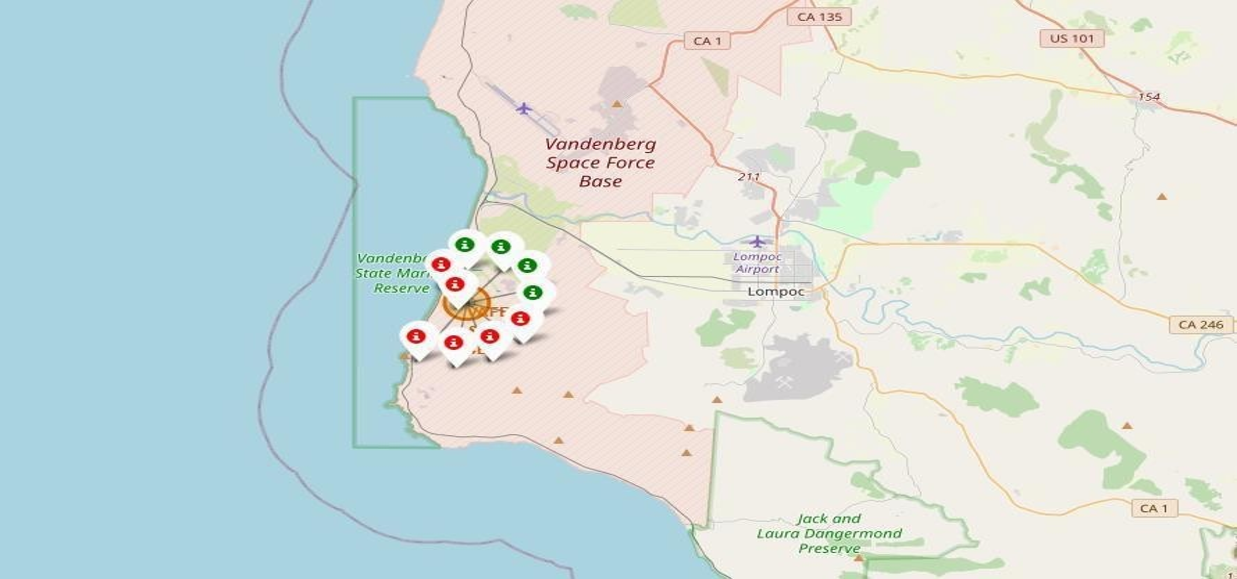
Color coded launch markers
On the Folium map, clusters can be interacted with to reveal the details of each landing attempt; successful landings are indicated by green icons, while failed ones are denoted by red icons. In the given example, the VAFB SLC-4E site is illustrated to have experienced 4 successful landings and 6 failed landings.

Slide 38



Key Location Proximities
Taking KSC LC-39A as a case study, it's observed that launch sites are strategically situated near railways to facilitate the transportation of large parts and supplies. Additionally, these sites are positioned close to highways to ensure easy access for human and supply transport. Proximity to the coast is another characteristic feature of launch sites, aimed at directing potential launch failures towards the sea, thereby minimizing the risk of rockets falling over densely populated areas. This careful placement reflects a deliberate balance between operational efficiency and safety considerations.

Slide 39

Section 4

Slide 40


Successful launches across launch sites
The distribution of successful landings across all launch sites reveals that CCAFS LC-40, now known as CCAFS SLC-40, and KSC have an equal number of successful landings. However, it's noteworthy that a significant portion of these successful landings occurred before the site's name change. VAFB accounts for the smallest proportion of successful landings, which could be attributed to a smaller number of launches from this site and potentially higher challenges associated with launches from the West Coast.

Slide 41

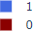
Highest success rate launch site
KSC LC-39A boasts the highest success rate, achieving 10 successful landings compared to 3 failed landings. This record underscores the efficiency and reliability of operations at this particular launch site.

Slide 42

Payload Mass vs Success vs Booster version category
The Plotly dashboard features a Payload range selector, initially configured to span from 0 to 10,000 kg, rather than extending up to the maximum Payload of 15,600 kg. This setup categorizes landing outcomes with '1' signifying a successful landing and '0' indicating a failure. Additionally, the scatter plot enriches its analysis by differentiating booster version categories through color variation and representing the frequency of launches by the size of the plot points. Notably, within the specific payload range of 0 to 6,000 kg, there are two instances of failed landings associated with payloads of zero kg, highlighting an intriguing aspect of the dataset that warrants further investigation.

Slide 43

Section 5

Slide 44
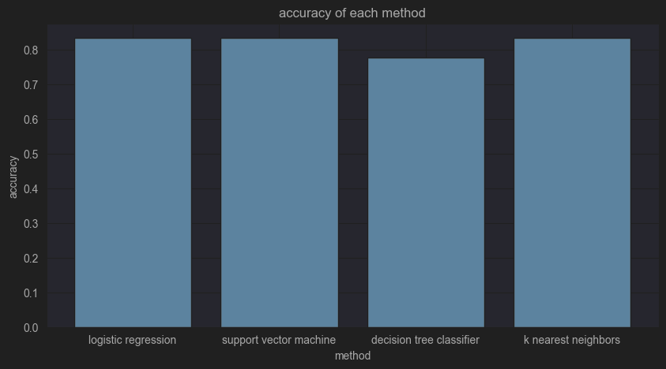
Classification Accuracy
The performance evaluation of all models on the test set revealed a uniform accuracy rate of 83.33%. However, it's important to note that the test size was relatively small, with only 18 samples. This limited sample size can lead to significant fluctuations in accuracy results across different iterations, particularly observed in the case of the Decision Tree Classifier model. The consistency in model performance under these conditions suggests that a larger dataset might be necessary to accurately distinguish the most effective model. Expanding the dataset could help in reducing the variance in accuracy results and provide a more reliable basis for model comparison and selection.

Slide 45
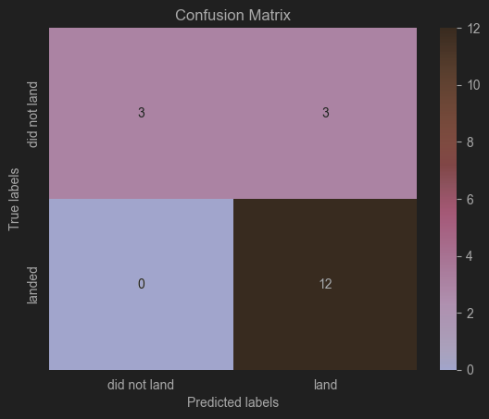
Confusion Matrix
Given the uniform performance of all models on the test set, the confusion matrix is identical for each model. Specifically, the models accurately predicted 12 instances of successful landings when the actual outcome was indeed successful. Similarly, they correctly identified 3 instances of unsuccessful landings when the true label matched this outcome. However, there were 3 instances where the models incorrectly predicted successful landings despite the true label indicating unsuccessful outcomes, categorizing these as false positives. This pattern suggests that the models have a tendency to overestimate the likelihood of successful landings.

Slide 46
Conclusions
Our project involved developing a machine learning model for Space Y, aiming to compete with SpaceX by predicting the success of Stage 1 landings, potentially saving approximately $100 million USD per launch. We sourced data from a public SpaceX API and extracted additional information through web scraping the SpaceX Wikipedia page. After refining the data and creating appropriate labels, we stored it in a DB2 SQL database for structured access and analysis.
To facilitate interpretation and analysis of the data, we designed a dashboard that visually represents the insights derived from our dataset. The culmination of our efforts was the creation of a machine learning model that achieved an accuracy of 83%. This model enables Allon Mask of SpaceY to forecast with a relatively high degree of certainty whether a launch will result in a successful Stage 1 landing. Such predictions are crucial for making informed decisions on whether to proceed with a launch.
Despite the model's promising accuracy, we acknowledge the limitation posed by the available dataset's size and diversity. For enhanced model performance and to ensure a more robust prediction capability, we recommend the acquisition of additional data. Expanding the dataset would allow for a more comprehensive evaluation of potential machine learning models and could lead to improvements in predictive accuracy, thereby better serving Space Y's strategic objectives.

Slide 47
Appendix
Include any relevant assets like Python code snippets, SQL queries, charts, Notebook outputs, or data sets that you may have created during this project

Slide 48


